Slide 1
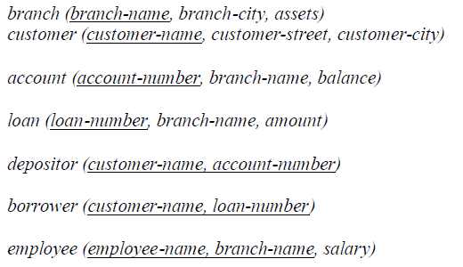

Slide 2
1. Find all account whose balance is smaller than 500.
2. Find all name of customers whose city is in Brooklyn
3. Find all employees whose salary is greater than 1400 and working branch is not ‘Downtown’
4. Calculate the average salary of all employees and show the average salary as “avg_salary”
5. Calculate the number of customer for each account
6. Show all account_number, branch_name and corresponding branch_city

Slide 3
1. Find the number of employees in each branch.
2. Find the names of all branches in the loan relation, don't display duplicates.
3. Find the customers who have an account but no loan.
4. Find the account number for all accounts where the balance is greater than $700.
5. Find the account number and balance for all accounts from Brighton where the balance is greater than $800.
6. Display the name of all customers who have a loan and an account at bank(using Nested Query)
7. Find the name of all branches with assets between one and four million dollars.
8. Find the name, account number, and balance of all customers who have an account.
9. Find the name, account number, and balance of all customers who have an account with a balance of $400 or less.

Slide 4
1. Find all account whose balance is smaller than 500.
Answer: select account_name from account where balance < 500;
2. Find all name of customers whose city is in Brooklyn
Answer: select customer_name from customer where customer_city='Brooklyn';
3. Find all employees whose salary is greater than 1400 and working branch is not ‘Downtown’
Answer: select * from employee where salary>1400 and branch_name<>’Downtown’;
4. Calculate the average salary of all employees and show the average salary as “avg_salary”
Answer: select avg(salary) as avg_salary from employee ;
5. Calculate the number of customer for each account
Answer: select account_number, count(distinct customer_name) from depositor group by account_number;
6. Show all account_number, branch_name and corresponding branch_city
Answer: select account_number, branch.branch_name, branch_city from account, branch where account.branch_name=branch.branch_name;

Slide 5
select account_number, balance from account where balance > 800 and branch_name = 'Brighton'
select branch_name from branch where assets between 1000000 and 4000000
select customer_name, borrower.loan_number, amount from borrower, loan
where borrower.loan_number = loan.loan_number and branch_name = 'Perryridge';
select depositor.customer_name, account.account_number, balance
from depositor, account where depositor.account_number = account.account_number
select depositor.customer_name, account.account_number, balance from depositor, account
where depositor.account_number = account.account_number and balance <= 400

